Slide 1
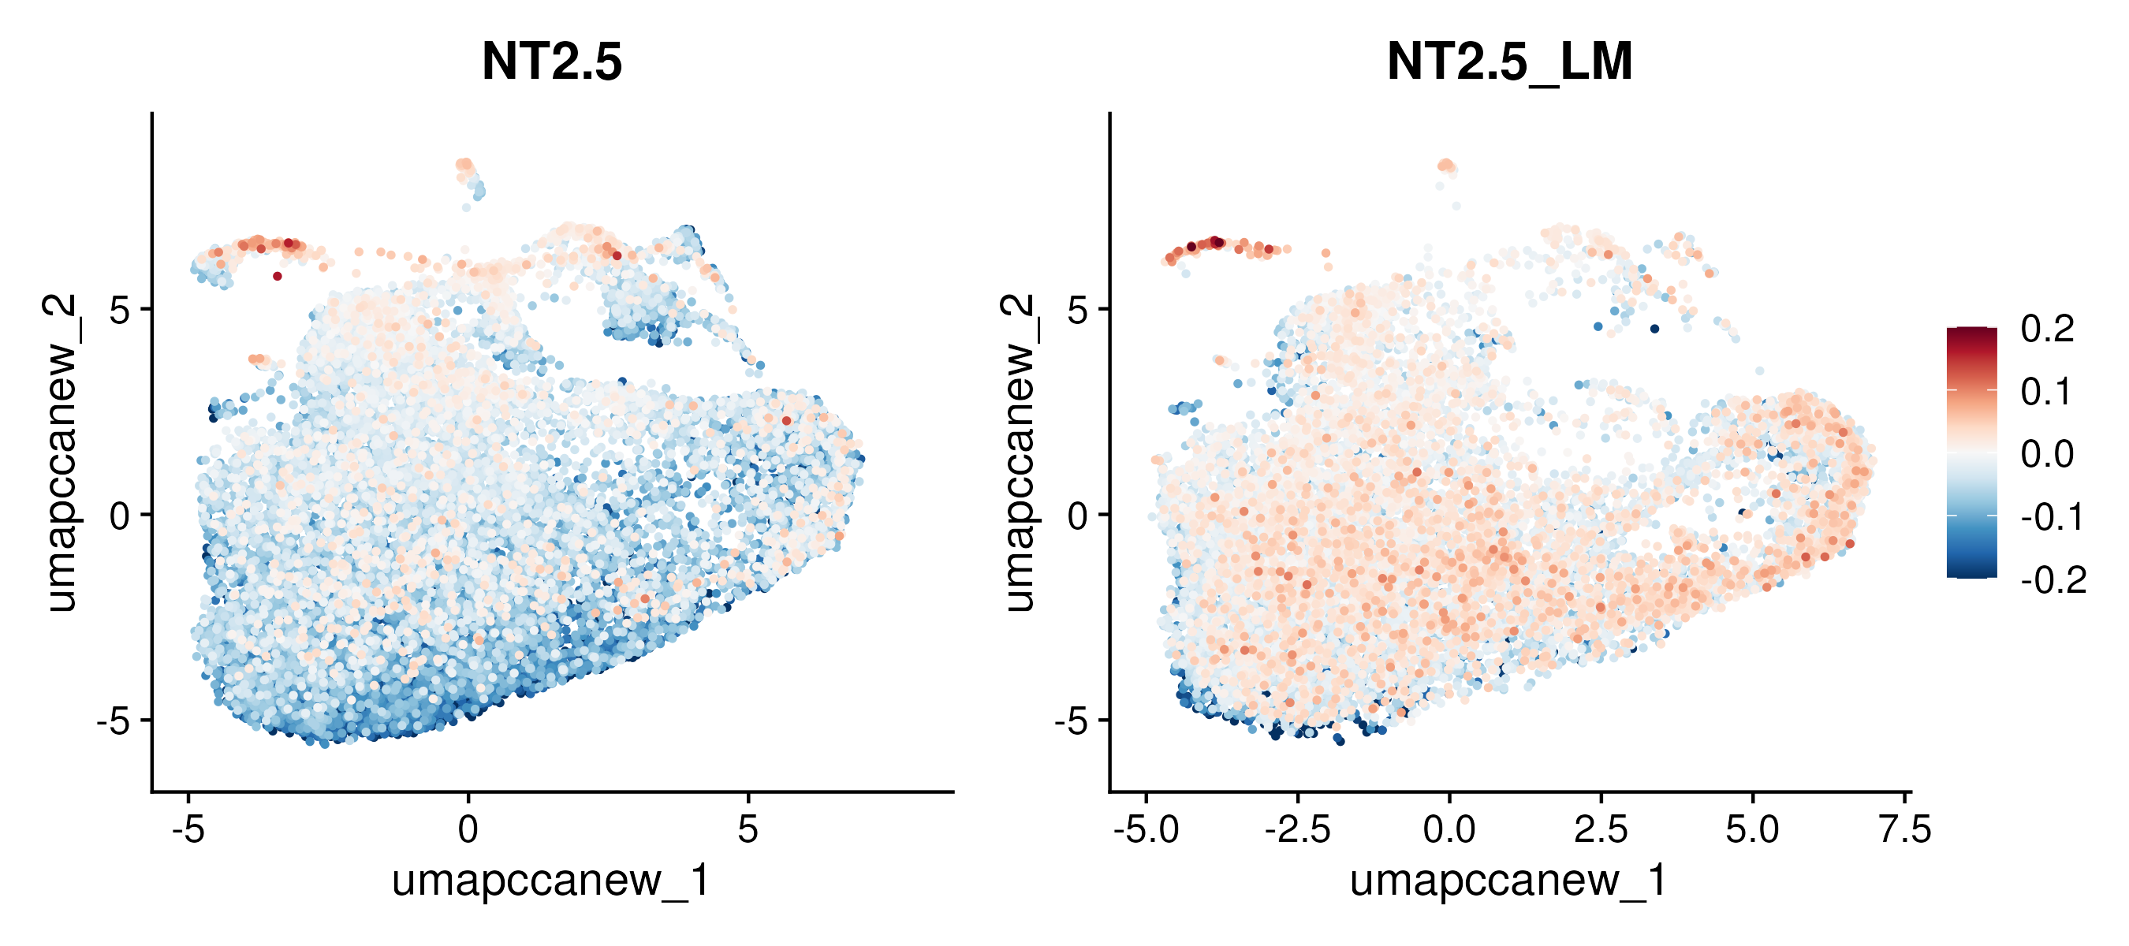
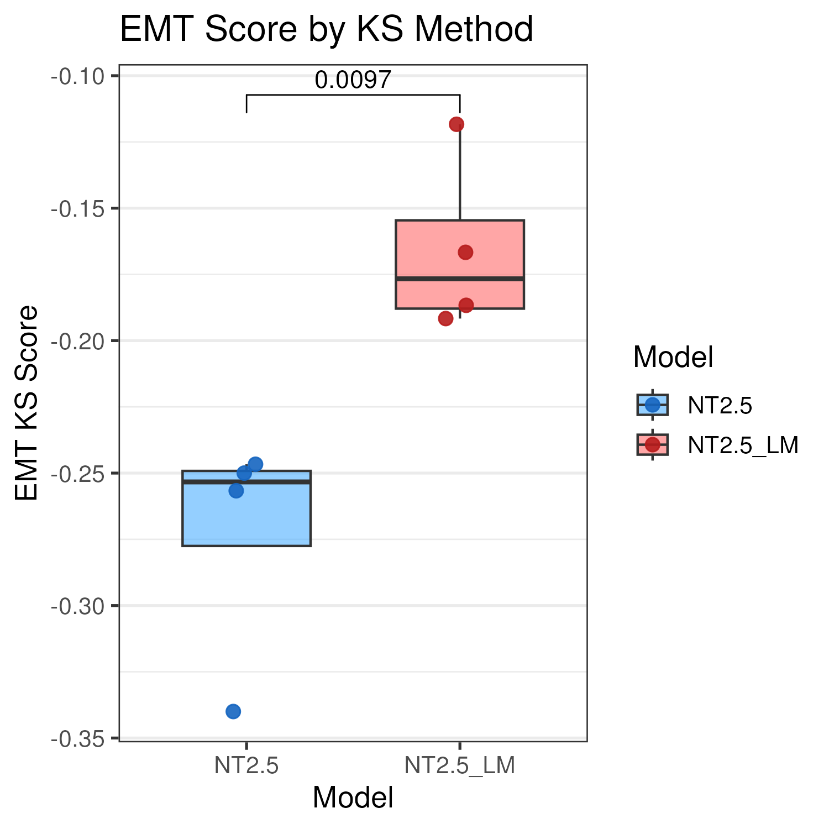
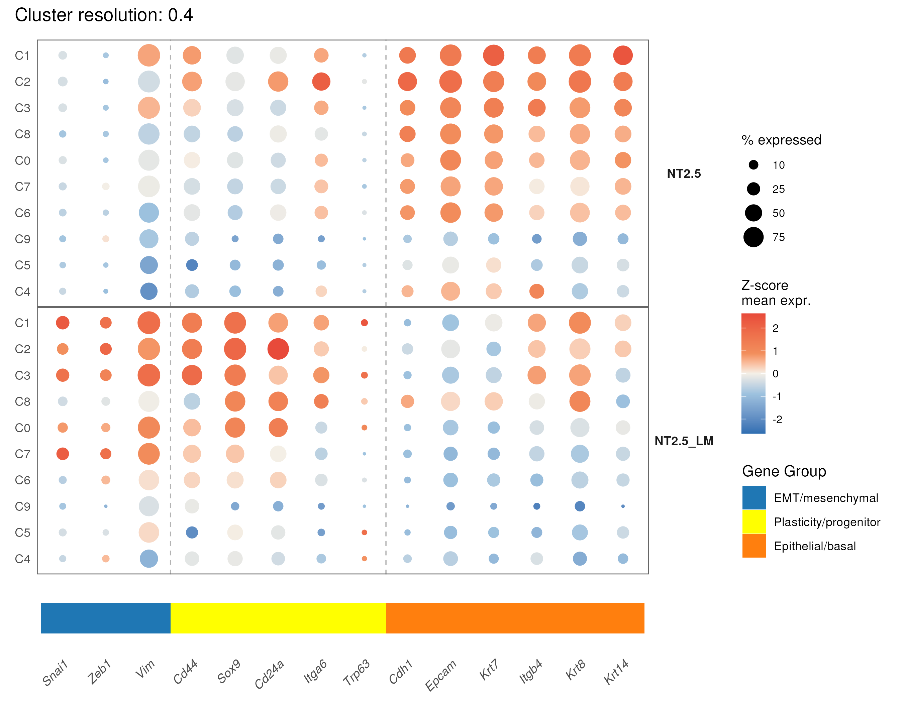
Fig.1
a
b
c
d
e
Lapatinib - CTG
Tucatinib - CTG
f
g
ML210 – sytox green
Incucyte (kinetic curves stop at 24hrs)
ML162 - Incucyte (kinetic curves stop at 24hrs)
h
i
Histogram for lipid peroxidation
Quantification here
(box plot)
Sytox green with cell death inhibitors (box plot, use endpoint)
j
NT2.5
NT2.5-LM
ML210
Liproxstatin-1
-
+
+
-
+
+
-
-
+
-
-
+

